Slide 1


人教版高中英语新教材
必修 第一册
Welcome Unit
Listening and Talking

Slide 2
■ Pre-listening
■ Pre-listening
Background information:
Learning styles. One’s learning style is the preferred way a person likes to learn, or the way they learn best, based upon their personality and temperament (个性与气质). There are seven generally accepted learning styles: visual, aural, verbal, physical, logical, social, and solitary (七种基本的学习风格为：视觉、听觉、口头(言语)、动觉性、逻辑(数学)、社交和独立型). Most students learn towards more than one learning style.

Slide 3

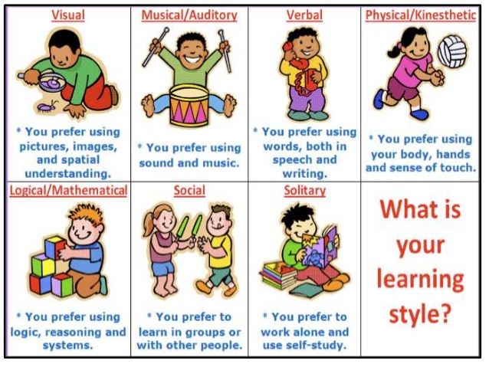
What is
your
learning
style?

Slide 4


The the
If I am an auditory learner, which learning strategy is more suitable for me?
Notes: You may learn better if you choose learning strategies well-suited to your style of learning!

Slide 5

work in groups
listen to the teacher and take notes
watch videos
use flash cards
make mind maps
keep a learning diary
Li Ming and Amy are talking about learning strategies.
Have you ever tried them before?
Which one do you think is the most effective?

Slide 6

Listen to their conversation and tick what Li Ming likes to do.
Tips: Focus on what Li Ming says and Listen for key words.
work in groups
listen to the teacher and take notes
watch videos
use flash cards
make mind maps
keep a learning diary
√
√
√
√

Slide 7


Listen again and answer the questions.
1. Why does Amy like group work?
2. How does Li Ming remember things?
3. How does Li Ming organise his thoughts?

Slide 8


1. Why does Amy like group work?
She is outgoing and talking to others helps her remember things.
Does group work help Amy learn better? Why?
Amy: Group work is my favorite way to learn. I'm an outgoing person, so I like to discuss things. Talking to others helps me remember things.

Slide 9
2. How does Li Ming organise his thoughts?
He makes mind maps to organise his thoughts.
How do you organise your thoughts?
Li Ming: Yes, I guess so. I learn best when I look at pictures, so I make mind maps to organize my thoughts. I keep a learning diary, too. I write down what I've learnt and my thoughts. It helps me plan my learning and what I need to review for exams.

Slide 10


3.Does Li Ming like to keep a learning diary?
Why or why not？
Yes, because it helps him plan his learning and what need to review for exams.
Do you have the habit of keeping an learning diary?
I keep a learning diary, too. I write down what I’ve learnt and my thoughts. It helps me plan my learning and what need to review for exams.

Slide 11
A:Hi,Li Ming. Ready for the test？Do you have any study tips for me ?
L:Not really. I just listen to the teacher and take notes.
A:Oh,group work is my favourite way to learn. I’m an outgoing person,so I like to discuss things. Talking to others helps me remember things.
L:I’m not very good at group work but I have other ways of remembering things.I like using flash cards. They are really effective.
A:Hmm…Notes and flash cards…I think you’re a visual learner.
L:Yes, I guess so. I learn best when I look at pictures, so I make mind maps to organise my thoughts. I keep a learning diary, too. I write down what I’ve learnt and my thoughts. It helps me plan my learning and what need to review for exams.
A:Ah, that’s a good idea. I want to try that! My friends and I have a study group .We talk about what we’re learning and help each other .Why don’t you join us?
L:Sure, I’d like that.

Slide 12




How do you learn English?

Slide 13
Rate the learning methods below.
1. I have learning goals and make plans for my English study.
2. I exchange learning experience with my classmates.
3. I take notes while listening and reading.
4. I read English newspaper and magazines.
5. I write down new words in my notebook and review them often.
6. I use dictionaries to check for new words.
7. I like to write about what I read or hear in English.
8. I like to watch movies in English.
9. ？
10.？

Slide 14
Check and Reflect.
How many stars have you got?
0-8 | English learning is a long-term process, which needs great effort and pay. It is recommended that you should adopt different learning strategies to make the whole process less boring, more interesting.
9-24 | You have certain ways to learn English. Why don't you try some creative new strategies, which might follow unexpected results?
25-40 | You have highly flexible methods of English learning, which is greatly praised. Go share your learning strategies with others.

Slide 15
Talking
Discussion and sharing
4. Learning about the new words:
1) flash n. 光；信号 vi. 闪耀；闪光；发出信号
vt. 使闪耀；发出（信号）
e.g. A flash of lightning lit up the night sky. 一道闪电照亮夜空。
Lightning flashed in the distance. 远处电光闪闪。
A terrible thought flashed through my mind.
一个可怕的想法闪过我的脑海。
The guide flashed a light into the cave.
导游用手电筒照射洞穴。

Slide 16
Talking  Discussion and sharing
4. Learning about the new words:
3) improve vt. vi. 改进；改善；提高
improvement n. 改进，改善
e.g. I need to improve my English. 我得提高我的英语水平。
You could use the money for improving your home.
你可以用这笔钱改善家居。
He said he was going to improve his football.
他说他要提高足球技术。
The doctor says she should continue to improve (= after an illness). 医生说她还会继续康复。
There is still room for improvement in your work.
你的工作尚有改进的余地。

Slide 17
Talking  Discussion and sharing
4. Learning about the new words:
2) organise vt. 组织；筹备；安排；组建 vt. 组建，成立
organisation n. 组织；团体；机构
e.g. In the end, we all decided to organize a concert.
最终，我们一致决定组织一场音乐会。
I’ll invite people if you can organize food and drinks.
如果你能备办饮食，我就负责请人。
He began to organize his materials. 他开始整理材料。
You should try and organize your time better.
你应该尽量更有效地分配你的时间。
Several projects have been delayed by poor organisation.
几个项目都因组织不力而被推迟。
the World Health Organization (WHO) 世界卫生组织

Slide 18
New words | Grammar | Reading skills | Writing | Speaking | Listening
Learning strategies
flash cards | listen to the teacher and take notes | read detective novels | keep a journal | chat with native speakers online | watch Friends
Homework:
1.Finish the chart , reflecting , adjusting and forming your own learning strategies.
2. Arrange notes to consolidate the new language items learned in this period. 3.完成阅读作业

